Slide 1

Beyond Frequencies: Graph Pattern Mining in Multi-weighted Graphs
Giulia Preti
Matteo Lissandrini, Davide Mottin, Yannis Velegrakis

Slide 2
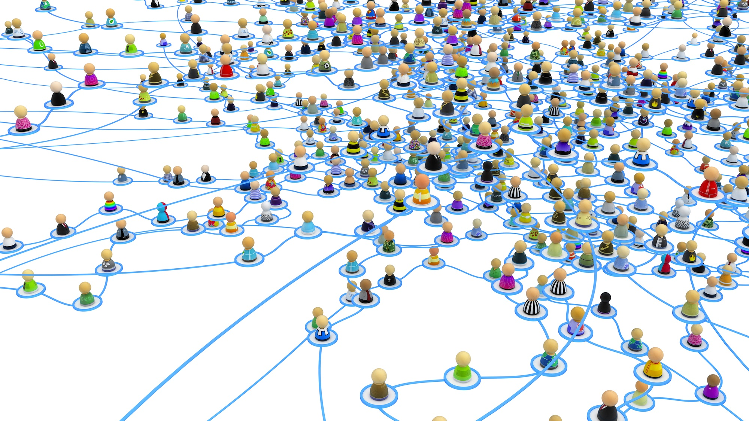
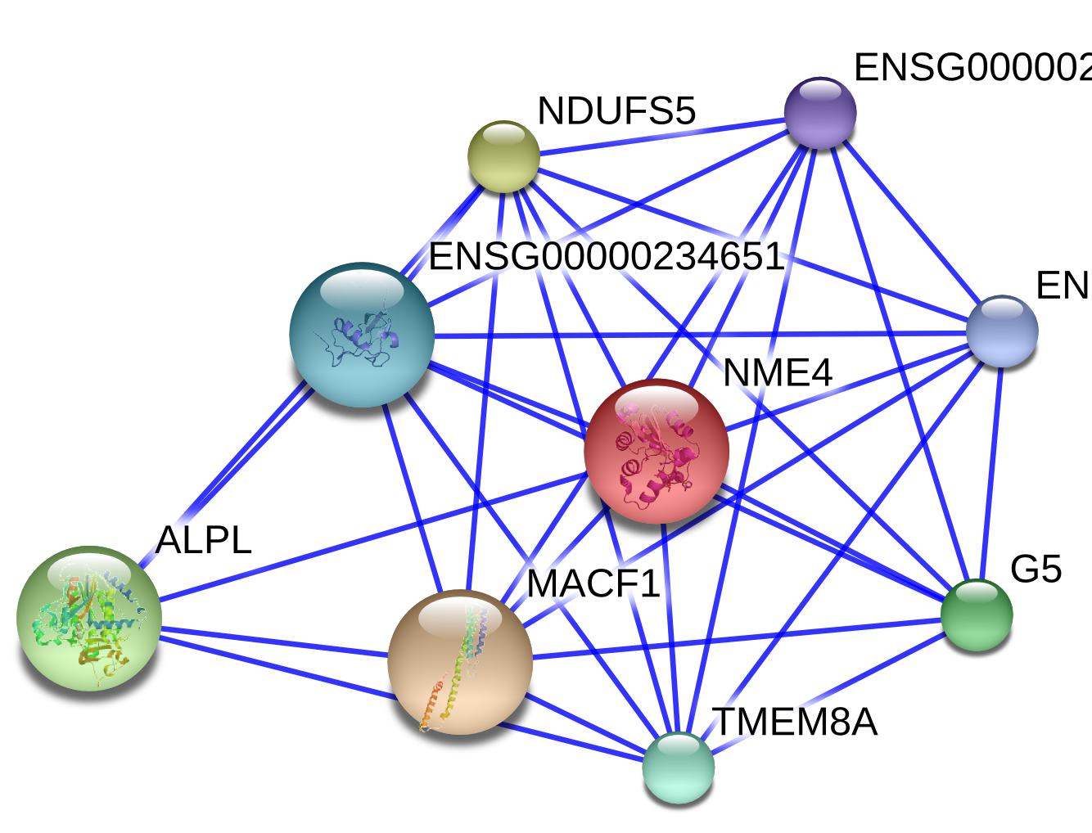
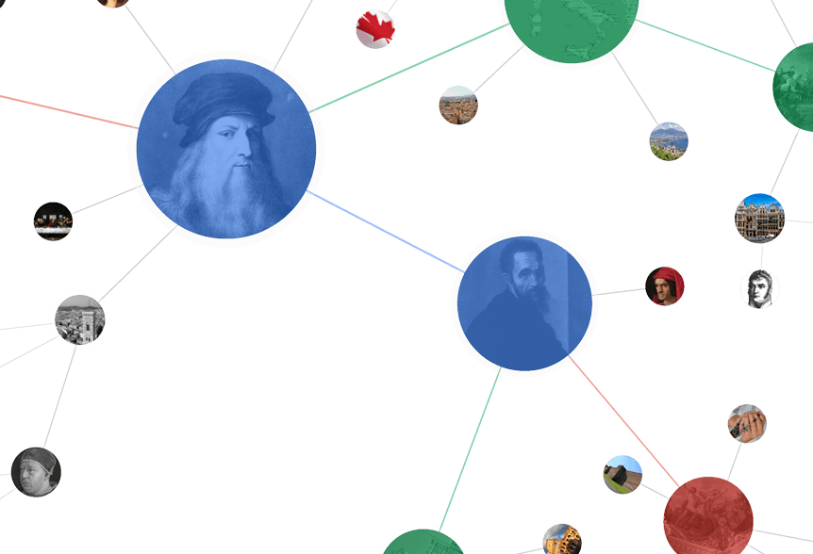
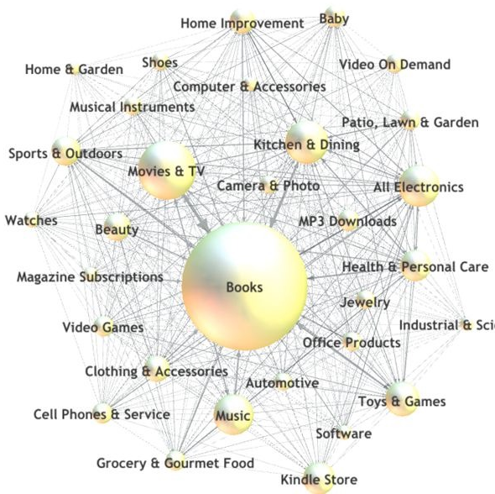
Graphs
Social Networks
Biological Networks
Knowledge Bases
Co-purchase Networks

Slide 3








Graph Pattern Mining
Frequent
Pattern

Slide 4

Preferences in Graphs
Frequent
Pattern
But I like
2
4
0
4
5
1
1
1
4
0
1
3
0
3
0
0
5
3
4

Slide 5
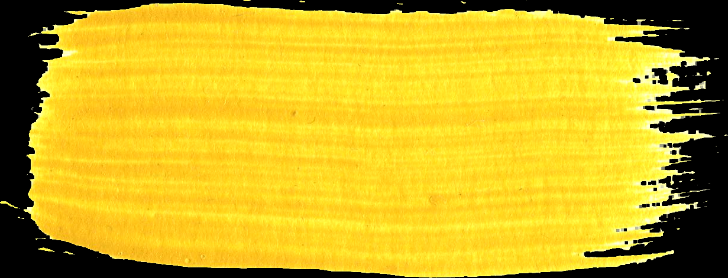
Related Work
  Graph Databases
  Forage [1]
  closed patterns
  synthetic patterns
  SPIN [2]
  maximal patterns
  WTMaxMiner [3]
  maximal weighted frequent patterns
  user transaction
  ATW/AW/UBW-gSpan [4]
  average total weighting
  affinity weighting
  utility-based weighting
  Single Graphs
  GraMi [5]
  all the frequent patterns
  SkyGraph [6]
  skyline patterns
  structural constraints
  WIGM [7]
  weighted graphs
  average aggregated weight
  1-extension property
Disregard weights!
Different definition of support!
Costly to scale!

Slide 6



Multiple Users
310M active users in 2016

Slide 7

Multiple Users --> Multiple Weights
G <V, E, 𝛴, 𝓵, 𝙒> W= {𝜔₁, 𝜔₂}
$ω_{1}:E→\left[0, 1\right]$
$$ω_{2}:E→\left[0, 1\right]$$
2
5
4
3
0
4
4
0
5
1
5
1
How can we find relevant patterns for 310M users?
5
1
3
4
1
1
0
4
1
5
0
3
3
5
3
1
0
0
5
5
3
0
4
4
0
5

Slide 8

Pattern Mining in Multi-weighted Graphs
Problem Statement
  INPUT
  a multi-weighted graph $G$
  a threshold $τ$
  a scoring function $f:𝒫 × 𝒢→ℝ$
  OUTPUT
  $∀ω_{i}∈W$
  the set $ℛ_{i}=\left\{P \right| G^{′}=\left\langle V,E,ℓ,ω_{i}\right\rangle ∧f\left(P, G′\right)≥τ\}$
Which function f ?

Slide 9

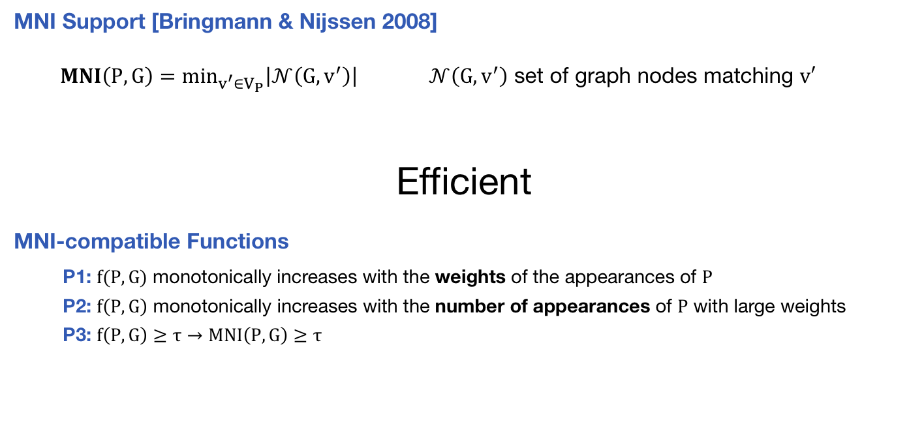
MNI-compatible Functions
  MNI Support [Bringmann & Nijssen 2008]
  $MNI\left(P,G\right)=min_{v^{′}∈V_{P}}\left|𝒩\left(G, v^{′}\right)\right|$ $𝒩\left(G,v^{′}\right)$ set of graph nodes matching $v′$
Efficient
MNI-compatible Functions
P1: $f(P,G)$ monotonically increases with the weights of the appearances of $P$
P2: $f\left(P,G\right)$ monotonically increases with the number of appearances of $P$ with large weights
P3: $f\left(P,G\right)≥τ→MNI\left(P,G\right)≥τ$

Slide 10
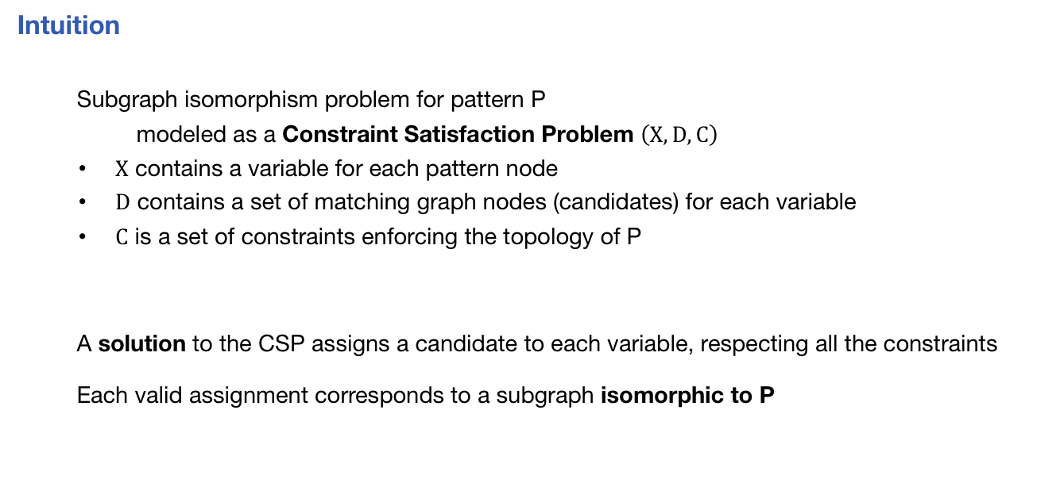
Our Exact Solution
Intuition
Subgraph isomorphism problem for pattern P
modeled as a Constraint Satisfaction Problem $\left(X, D, C\right)$
        $X$ contains a variable for each pattern node
        $D$ contains a set of matching graph nodes (candidates) for each variable
        $C$ is a set of constraints enforcing the topology of P
A solution to the CSP assigns a candidate to each variable, respecting all the constraints
Each valid assignment corresponds to a subgraph isomorphic to P

Slide 11
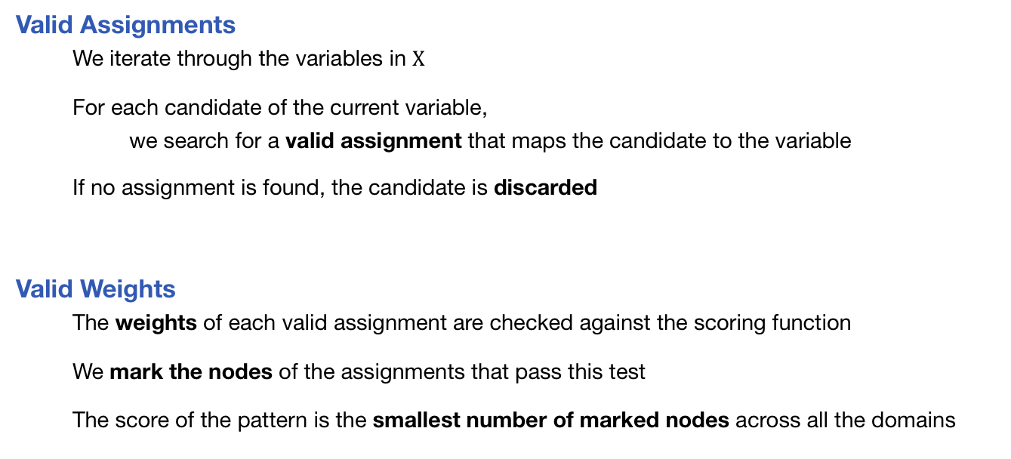
Computation of the Pattern Score
Valid Assignments
We iterate through the variables in $X$
For each candidate of the current variable,
we search for a valid assignment that maps the candidate to the variable
If no assignment is found, the candidate is discarded
Valid Weights
The weights of each valid assignment are checked against the scoring function
We mark the nodes of the assignments that pass this test
The score of the pattern is the smallest number of marked nodes across all the domains

Slide 12

What About Multiple Users?
Complexity for Single User
$C=O\left(2^{{\left|V\right|}^{2}}{\left|V\right|}^{|V_{P}|}\right)$
Multi-weighted Graphs
Mining the relevant patterns for each user is expensive
  Mining the patterns for each user is unnecessary
  EXACT SOLUTION: parallel score computation + compact data structures
310M active users in 2016

Slide 13
Our Approximate Solution
Two-step Approach
    Generate k representative users
        Create feature vectors
        Identify similar users
        Generate maximum-weight vectors
    Compute k approximate sets of patterns
        Run ReSuM with the representative users
Pros
Reduced memory consumption
Reduced running time
Cons
Spurious Patterns

Slide 14
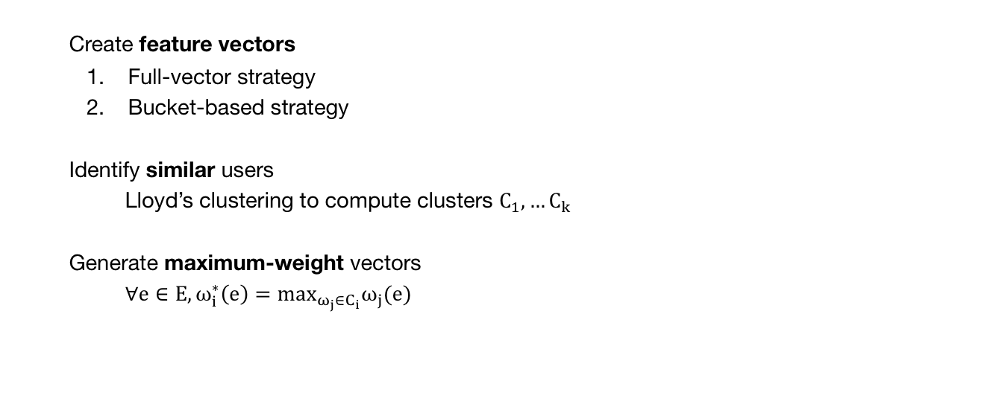
Generate k Representative Users
Create feature vectors
        Full-vector strategy
        Bucket-based strategy
Identify similar users
Lloyd’s clustering to compute clusters $C_{1}, …C_{k}$
Generate maximum-weight vectors
$∀e∈E, ω_{i}^{∗}\left(e\right)=max_{ω_{j}∈C_{i}}ω_{j}(e)$
Complete Pattern Sets!

Slide 15
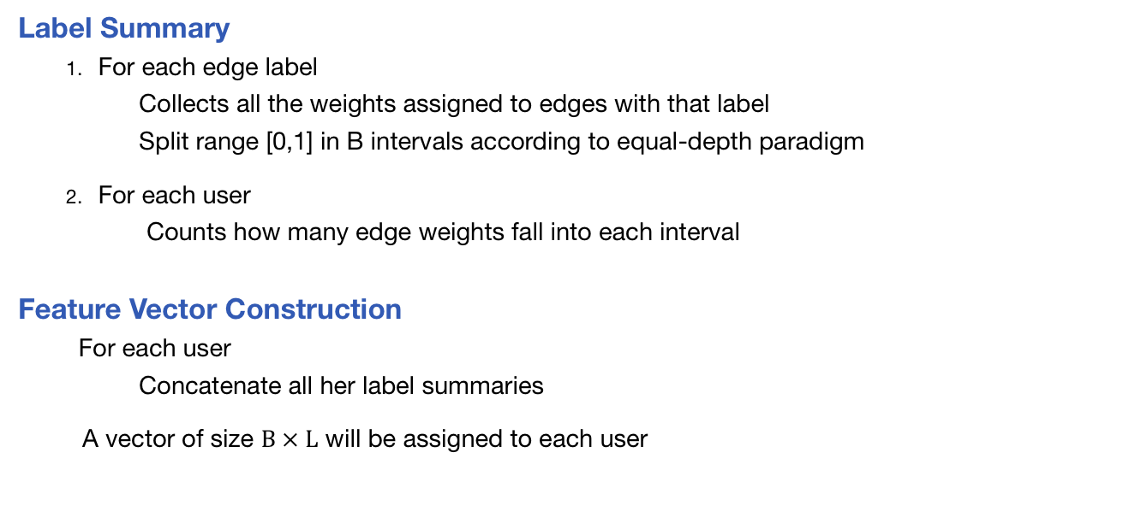
Bucket-based Strategy
  Label Summary
      For each edge label
  Collects all the weights assigned to edges with that label
  Split range [0,1] in B intervals according to equal-depth paradigm
      For each user
      Counts how many edge weights fall into each interval
  Feature Vector Construction
  For each user
  Concatenate all her label summaries
      A vector of size $B × L$ will be assigned to each user

Slide 16

Quality of the Approximation
Accuracy
$A=\frac{1}{m}Σ_{i=1}^{m}\left|R_{i}∩A_{i}\right|/|R_{i}|$
Average pattern set distance
$d\left(P_{i},R_{j}\right)=argmin_{P_{k}∈R_{j}}Levenshtein\left(P_{i}, P_{k}\right)$
$Q=\frac{1}{m}Σ_{i=1}^{m}{\frac{1}{\left|A_{i}\right|}Σ}_{P_{k}∈A_{i}}d\left(P_{k},R_{i}\right)$

Slide 17
Our MNI-compatible Functions
Which isomorphic subgraphs contribute to the pattern score?
ALL
Subgraphs whose edges have large weights
        You know preferences for almost all the nodes/edges
        You find only the most relevant patterns
ANY
Subgraphs with at least one large edge weight
        The data is incomplete
        You are able to provide some results

Slide 18
Our MNI-compatible Functions – Cont’
Which isomorphic subgraphs contribute to the pattern score?
SUM
Subgraphs where the sum of the edge weights is large
        You account for each contribution to value a structure
        E.g. you consider purchases where the user spent a minimum amount of money
AVG
Subgraphs with a large average edge weight
        You consider patterns with both large-weighted and small-weighted appearances
        You return patterns relevant on average

Slide 19
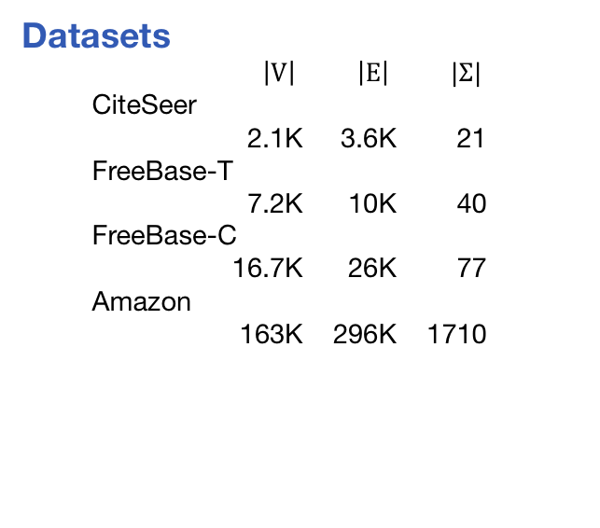
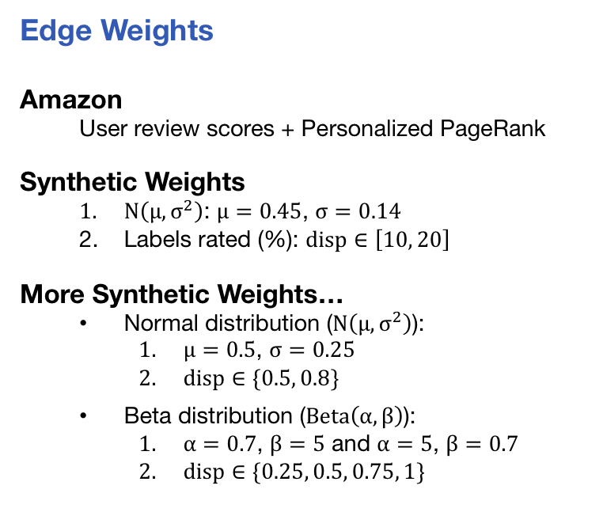
Experimental Setup
Datasets
$\left|V\right| \left|E\right| |Σ|$
CiteSeer
2.1K 3.6K 21
FreeBase-T
7.2K 10K 40
FreeBase-C
16.7K 26K 77
Amazon
163K 296K 1710
Edge Weights
Amazon
User review scores + Personalized PageRank
Synthetic Weights
  $N\left(μ, σ^{2}\right)$: $μ=0.45$, $σ=0.14$
  Labels rated (%): $disp∈\left[10, 20\right]$
More Synthetic Weights…
  Normal distribution ($N\left(μ, σ^{2}\right)$):
    $μ=0.5$, $σ=0.25$
    $disp∈\{0.5, 0.8\}$
  Beta distribution ($Beta\left(α,β\right)$):
    $α=0.7$, $β=5$ and $α=5$, $β=0.7$
    $disp∈\{0.25, 0.5, 0.75, 1\}$

Slide 20
Frequent vs Relevant Patterns
The scoring function affects the patterns returned
Frequent patterns upper bound on relevant patterns
Relevant patterns reduce information overflow

Slide 21
Impact of the Scoring Function
Performance not worse than FPM

Slide 22
Multi-weighted Graphs
When the exact solution becomes impractical, trade accuracy for performance

Slide 23
Impact of Amount of Weighted Edges
Stable performance

Slide 24
Conclusions
  We showed that weights are important for graph pattern mining
  We introduced the problem of pattern mining in large multi-weighted graphs
  We devised an exact and an approximate solution
  We proposed four efficient MNI-compatible functions
  We empirically showed that our approach is scalable
  and can discover relevant patterns

Slide 25
Thank you!
gp@disi.unitn.eu

Slide 26
References
  [1] F. Pennerath and A. Napoli. Mining frequent most informative subgraphs. In Mining And Learning With Graphs, 2007.
  [2] Huan, W. Wang, J. Prins, and J. Yang. Spin: mining maximal frequent subgraphs from graph databases. In Proceedings of the 2004 ACM SIGKDD international conference on Knowledge discovery and data mining, pages 581–586, 2004.
  [3] R. Geng, X. Dong, P. Zhang, and W. Xu. Wtmaxminer: Efficient mining of maximal frequent patterns based on weighted directed graph traversals. In Cybernetics and Intelligent Systems, 2008 IEEE Conference on, pages 1081–1086, 2008.
[4] C. Jiang, F. Coenen, and M. Zito. Frequent subgraph mining on edge weighted graphs. In Data warehousing and knowledge discovery, pages 77–88. 2010.
  [5] M. Elseidy, E. Abdelhamid, S. Skiadopoulos, and P. Kalnis. Grami: Frequent subgraph and pattern mining in a single large graph. Proceedings of the VLDB Endowment, 7(7):517–528, 2014.
  [6] A. N. Papadopoulos, A. Lyritsis, and Y. Manolopoulos. Skygraph: an algorithm for important subgraph discovery in relational graphs. Data Mining and Knowledge Discovery, 17(1):57–76, 2008.
  [7] J. Yang, W. Su, S. Li, and M. M. Dalkilic. Wigm: Discovery of subgraph patterns in a large weighted graph. In SDM, pages 1083–1094, 2012.
  [8] Bjorn Bringmann and Siegfried Nijssen. 2008. What is frequent in a single graph?. In PAKDD. 858–863.

